Slide 1
Vue with Typescript and .NET core
By Radim
Moto: KISS – KEEP IT SIMPLE STUPID (extreme programming rule)
Simplicity is the Ultimate Sophistication - Davinci, S.Jobs…

Slide 2
Why Typescript? (ts)
Babel is awesome but you need to configure a lot like –
Flow (types support), ES6 Linters etc. updating it..
Typescript – you configure only ONE guy
Babel + Flow ==? Typescript + null + Enums etc.
Official Vue support of Vue-class-component and *.vue files
Using vue-class-component, decorators from vue-property-decorator libs
Intellisense, possible to pack it with cordova or electron to make it desktop, mobile (Ios, android) app
Dissadvatages : sometimes you write more as you would with babel 344 lines vs. 350 in ts

Slide 3
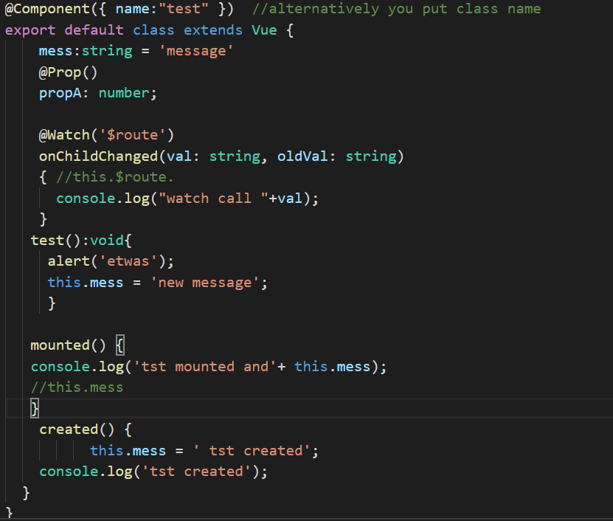
Component looks like
Import { component, inject, model, prop, watch } from 'vue-property-decorator‚
}

Slide 4
Why .NET core?
Runs f.e. on linux as a supervisor service .net kerstel server, nginx webserver
Use and Part of most perfomant (op/sec.) async backend servers in big three :
Go > .NET core > Node js
Can be utilised as SSR engine for vue
Use of Web API or/and libraries like SignalrR for duplex communication. websockets, EntityFramework etc.
Use of T4 to generate frontend proxies from domain code to target any language or platform (js, ts, java etc..)

Slide 5
T4 part
Its a text template with csharp code that generates text file of chosen format (code, xml, txt)
Just Dont do (urls, methods constantly changing) in vue file
Axios.get(’/posts/search’,{params: {search:’some string’}} )
T4 it
So have proxy in vue something like
this.db.getposts(’searchstring’, …)
Possible to extend any call with custom logic, changes made easily, intellisense + typecheck on compile

Slide 6
Demo

Slide 7
Sources & Thanks
Ts example:
github.com/Jack85/vuecore
Official
github.com/Microsoft/TypeScript-Vue-Starter
T4 .net core stuff
https://github.com/ZeekoZhu/TextTemplating
Performance:
https://raygun.com/blog/increased-throughput-net-core/
Contact
bousekr@gmail.com

